Slide 1
FHIR Questionnaires
Lloyd McKenzie
December 8, 2015

Slide 2

Who am I?
Name: Lloyd McKenzie
Company: Gevity
Background:
One of FHIR’s 3 principle editors
Co-chair FHIR Management Group, Modeling & Methodology, FHIR Infrastructure
Former Chair HL7 Canada Architecture & Infrastructure
Heavily involved in HL7 and healthcare exchange for last 15 years (v2, v3, CDA, etc.)

Slide 3
Tutorial Objectives
You should:
Be able to explain the capabilities of FHIR Questionnaires and how they’re intended to be used
Understand how Questionnaire and QuestionnaireResponse have evolved and why
Be familiar with more advanced Questionnaire capabilities, including use of extensions and the Structured Data Capture protocol
Notes:
9:15

Slide 4
FHIR Questionnaire Purpose & Usage

Slide 5
What is Questionnaire for?
Questionnaires are a typical means for capturing information from humans
Both within and outside of healthcare
Provide great control over data capture
What data is requested
How question is phrased
Constraints on allowed responses
In what order questions are presented
Under what circumstances information is needed

Slide 6
Alternatives to Questionnaire
Binary
For PDF/scanned/non-encoded raw data
Useful if need is for audit, not computability
Observation
“Everything’s an Observation”
Provides similar capabilities to Questionnaire, but intended use is “true” observation
Lab, vitals, measurements, assessments
Any resource
Capture Medication information as MedicationStatement
Allergies as AllergyIntolerances
Plans as CarePlan
Etc.

Slide 7
Questionnaire is appropriate when:
Tight control of data capture is needed
Data is being retrieved directly from humans
Important to track and retain “raw” information
E.g. For research purposes
“Normalization” of data needs to be centralized
Frequent need for evolution in data being captured

Slide 8
Avoid Questionnaire when:
Humans aren’t involved
There are more efficient ways to capture data
Data needs to be searched against/sorted/filtered
Interoperability is needed on data from multiple systems that won’t be using a single Questionnaire design

Slide 9
Combining solutions
Data can be captured using Questionnaires, then migrated to other resources for query/filtering/sorting
Computer systems can “populate” portions of a questionnaire for humans to review and supplement

Slide 10
Questionnaire resource family

Slide 11
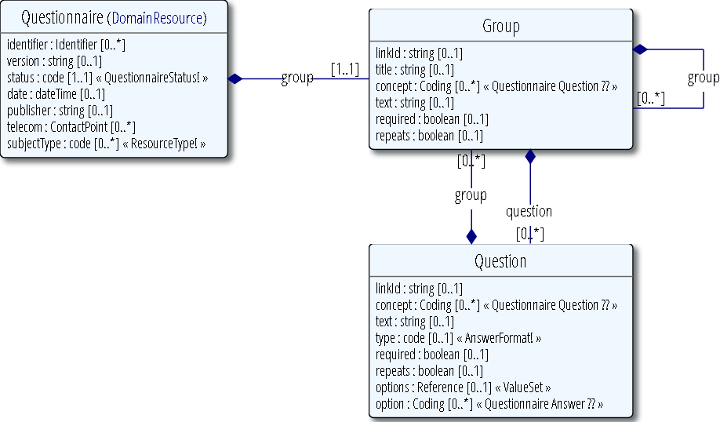
Questionnaire

Slide 12
Questionnaire
The “Definition” of the content to be captured
What questions are to be asked?
In what order?
How are they grouped?
What responses do they permit?
How is the content of the questionnaire rendered?
Are there rules about what content must or may be specified?

Slide 13
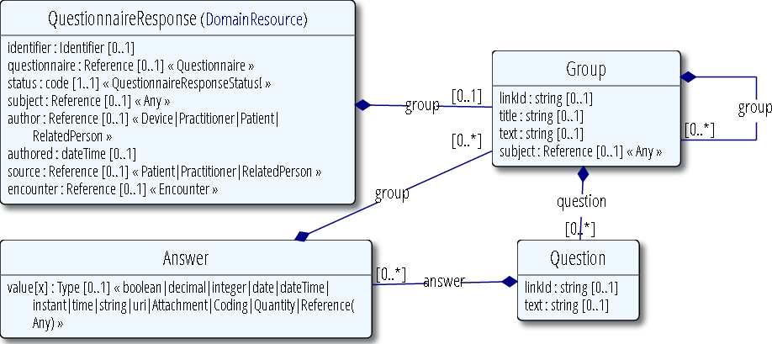
QuestionnaireResponse

Slide 14
QuestionnaireResponse
A completed (or partially) completed instance of a Questionnaire
There may be hundreds (or thousands) of QuestionnaireResponses for one Questionnaire
QuestionnaireResponses can exist without a Questionnaire at all
Paper Questionnaire
Legacy data

Slide 15
Questionnaire re-factoring
Combined “question” and “group” into item
Added support for “display” items (and revamped several extensions as a result)
Rational
Allows mixing questions and groups within a group
Allows text content anywhere
Simplifies process for nesting content
Simplifies model overall

Slide 16
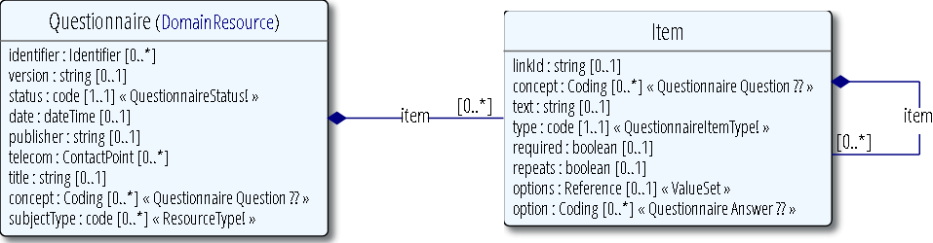
Revised Questionnaire model

Slide 17
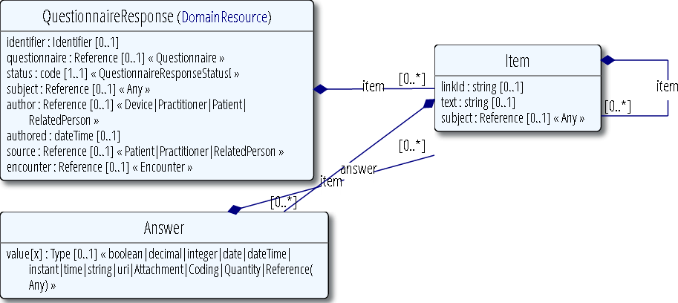
Revised QuestionnaireResponse

Slide 18
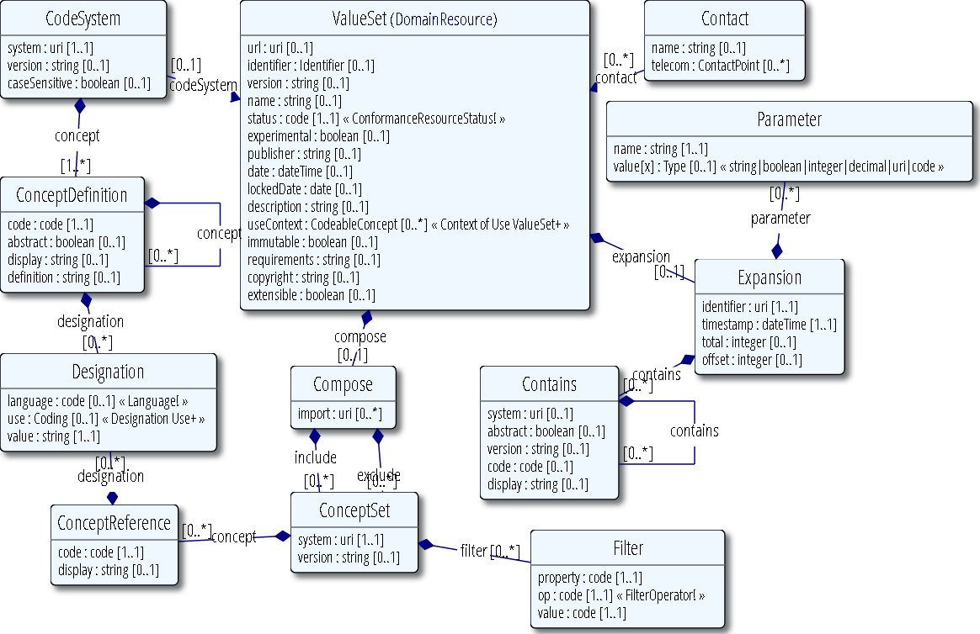
ValueSet

Slide 19
ValueSet
Provides allowed responses for “Choice” questions
Allows re-use of answer lists across questions & Questionnaires
Allows use of more advanced vocabulary capabilities
Intensional value sets
Coded ordinals
Mappings between terminologies

Slide 20
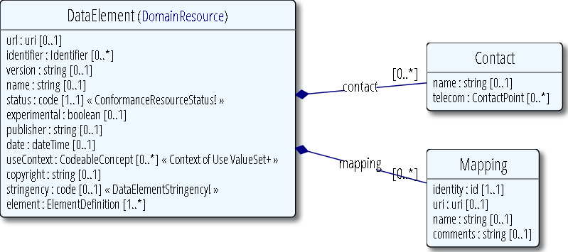
DataElement

Slide 21
DataElement
Re-useable “questions” (and groups)
Allow defining:
The meaning of the information to be captured
The text of the question to display
The allowed data type
Permitted choices for multi-choice answers
Helps ensure consistency of data captured by different Questionnaires
Requires good governance to be effective

Slide 22
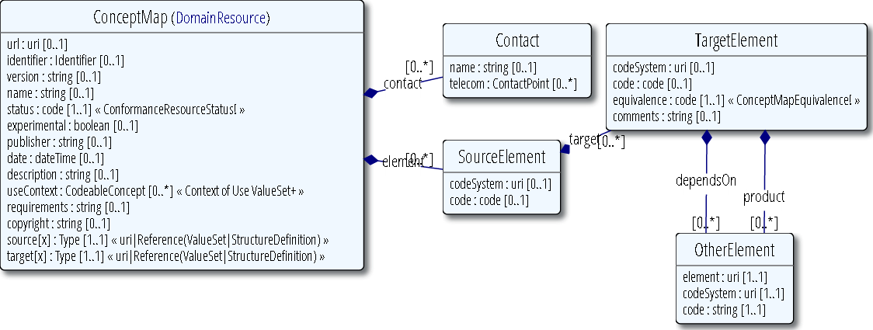
ConceptMap

Slide 23
ConceptMap
Allows linkages between Questionnaires and other things
Map questions & groups to resource elements
Map questions & groups to Data elements
Map questions & groups to non-FHIR specifications (v2, CDA, Open-HER)
Map between question choice values and formal value sets
System = questionnaire URL, code = linkId

Slide 24
Other resources
Provenance can be used to link a Questionnaire to the full-blown resource instance its data generated
Many resources (e.g. Observation) can point to Questionnaire as a “source” of information used to justify or support an assertion

Slide 25
Questionnaire Workflow

Slide 26
Workflow options
Questionnaires can be used with any of the FHIR interoperability paradigms
REST
Messaging
Documents
Services

Slide 27
REST
Simple Create/Read/Update/Delete functionality
For both Questionnaires and QuestionnaireResponses
POST a QuestionnaireResponse to “submit” it
Security layer is handled by HTTPS, OAuth, etc.
Request to complete a Questionnaire theoretically handled with Order/OrderResponse
Order/OrderResponse are being revamped as part of FHIR 2.1

Slide 28
Messaging
Useful for asynchronous communications or non-reliable connections
Allow a Questionnaire to be packaged with its value sets where containment is inappropriate
No “standard” questionnaire-related messaging events or profiles defined yet
Can use request/response nature of messaging to send Questionnaire, get back QuestionnaireResponse

Slide 29
Documents
Documents can include a QuestionnaireResponse as one of their sections (if appropriate for the data)
A Questionnaire can be sent as part of a document, though would rarely make sense as a stand-alone document
Can’t use document sections to split apart groups of questions in a Questionnaire

Slide 30
Services
Questionnaires are ideal for use with services
Submit data to a service as a QuestionnaireResponse
Takes care of the user-interface for prompting for service-specific data
Use services to convert QuestionnaireResponse data to other forms
Generate Questionnaire instances for data definition artifacts

Slide 31
Standard FHIR services
Questionnaire/$populate
Generate a QuestionnaireResponse for a specified Questionnaire, optionally filling in data from a local or submitted data
StructureDefinition/$questionnaire
Generate a Questionnaire for a specified data type, resource or profile

Slide 32
Workflow caveats
Workflow is a significant focus of FHIR DSTU 2.1
The Order/OrderResponse resources will definitely change
The MessageHeader (and messaging methodology) may evolve at least somewhat
Follow the FHIRWorkflow project to monitor

Slide 33
Using Questionnaire

Slide 34
Questionnaire Identifiers
id – RESTful id for the questionnaire on a specific server
meta.versionId – RESTful version (server-specific)
identifier – Business identifier for the questionnaire (consistent on different servers)
version – Business version label
linkId – Ties Questionnaire to Response

Slide 35
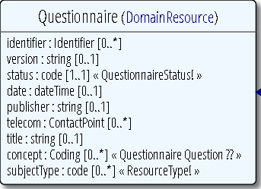
Questionnaire metadata
status: Is this questionnaire still active?
date: When did this status become effective
subjectType: What must QuestionnaireResponse.subject be?
concept: Code for the overall questionnaire

Slide 36
Linking Responses to Questionnaire elements
3 methods:
linkId – most preferred
may become only mechanism
text
Not very efficient from an execution perspective
Computation on human-readable content is risky
Lower overhead?
Positional
Presumes all elements are minOccurs=1

Slide 37
Using LinkId
Must be unique across entire Questionnaire
Not just within hierarchy
Can use a hierarchical approach
E.g. 1.2.5.3
Can be a UUID
UUIDs aren’t very developer friendly, but are simple

Slide 38
Handling repetitions
Each group/question/item can identify if it’s required or repeats
Extensions provide ability to provide explicit mins and maxes
E.g. 3..5
On response, if question has nested items, then item repeats for each value. Otherwise, item occurs once and each answer is a separate value

Slide 39
Item types
There are 3 main types of items in a questionnaire:
display – Cannot have an answer or nested items – just text for display
group – Cannot have an answer and must have nested groups and/or questions
question (abstract) – Can have an answer, but may also have nested items

Slide 40
Simple question types
boolean – true or false
integer or decimal – numeric values
date, dateTime, time, instant – valid dates and times or portions there-of
string, text – short or long strings of text
url – A valid web address
http, sendto, ftp, etc.
choice, open-choice – Used when user is restricted to choosing from a set of values

Slide 41
Complex question types
(These types have answers which may have multiple components)
quantity – numeric value plus variable unit
attachment – data with a mime type. E.g. Image, video, attached file
reference – pointer to another FHIR resource

Slide 42
Coded vs. uncoded choices
Choice is defined as a Coding
All “choice” responses are implicitly codes
“system” is optional
Including “system”
allows mappings
makes clear references to common code systems
adds overhead to instances

Slide 43
Defining allowed choices
3 options for defining allowed choices:
Enumeration of choice elements
Simplest
Choices maintained as part of Questionnaire
No re-use potential
Can’t leverage capabilities of ValueSet
Contained ValueSet
Can re-use within Questionnaire
Maintained as part of Questionnaire
Can leverage ValueSet capabilities
External ValueSet
Can re-use across questionnaires and with other artifacts
Not part of Questionnaire

Slide 44
Open-choices
Open-choice allows either a coded response or a string
More common pattern is coded choice + a string.
E.g. “Other – Please specify”
Handled with a conditional nested question

Slide 45
Using the Group/Question
In DSTU 2.0, groups and questions are separate
Groups can contain groups or questions, not both
If you need to mix, then wrap each stand-alone question in a group with no label
In DSTU 2.1 this is fixed by collapsing group and question into item

Slide 46
QuestionnaireResponse metadata
QuestionnaireResponse includes:
subject, author, authored, source, encounter
Traditionally, these are captured as separate answers in the Questionnaire
That doesn’t allow searching, filtering, privacy rule enforcement, etc.
Therefore, rendering tools should capture these elements from context and Questionnaires should exclude the questions from Questionnaire design

Slide 47
Why does Response echo text?
QuestionnaireResponse allows the name of the group or the text of the question to be included in the response
Rationale:
Every resource instance must be interpretable “stand-alone”
This is hard to do without section headers or question text
That said, these elements are optional

Slide 48
Referencing other Questionnaires
For re-use, sometimes one Questionnaire may want to reference a “child” Questionnaire
Use the “reference” type
Use extensions to constrain the target resource to be a QuestionnaireResponse conformant with a specific Questionnaire definition

Slide 49
Structured Data Capture

Slide 50
What is SDC?
SDC is a US-Realm project sponsored by the ONC
Aims to allow sharing of data element definitions and automated population of questionnaires
Multiple IGs
IHE implementation guide using custom schema focuses on Questionnaire
2 FHIR implementation guides
Questionnaire population focused
Data Element definition/exchange focused

Slide 51
What is SDC (cont’d)
FHIR SDC IG
Defines profiles on Questionnaire, QuestionnaireResponse & ValueSet setting minimum expectations for support
including use of several extensions
Defines Conformance roles for different systems participating in the Questionnaire exchange

Slide 52
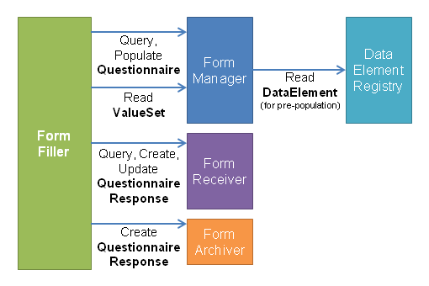
FHIR SDC overview

Slide 53
Questionnaire Extensions

Slide 54
Questionnaire use of extensions
Questionnaire tries to follow FHIR’s “80%” rule
Only include capabilities supported by at least 80% of systems
This is being re-evaluated based on FHIR implementation experience
For now, many capabilities are handled only through extensions

Slide 55
Extension types
Extensions defined on Questionnaire fall under one of 3 categories:
Metadata – Additional information used for searching/understanding
Answer constraints – Limit allowed answer values
Rendering controls – Affect how the Questionnaire is rendered
Behavior controls – Define how the Questionnaire behaves

Slide 56
Metadata
?-category – E.g. administrative, pediatrics, referral, etc.
?-deReference – Data element that corresponds to this question/group
?-deMap – ConceptMap that provides linkages between items and data elements
?-fhirType – FHIR data type that corresponds to a group

Slide 57
Answer Constraints
minLength – minimum # of characters
?-maxLength – maximum # of characters
minValue – low value for date/number/time
maxValue – high value for date/number/time
maxDecimalPlaces – for decimal values
maxSize – maximum size of attachment
regex – constrains strings to match specified pattern
entryFormat – instructions to user on what content should look like (non-computable)

Slide 58
Rendering controls
?-label – Number to place beside question/group heading. E.g. “A.1”
?-displayCategory – Identifies the type of display text (which generally affects how it renders)
E.g. Security text, flyover, units
style – Identifies the css style to apply to the element
markup – Provides a marked-up version of the string
allows embedded bold, subscripts, colors, etc. in a question or group label

Slide 59
Behavior controls
?-minOccurs & ?-maxOccurs – min and max occurrences for item
?-hidden – Item shouldn’t be displayed
e.g. internal metadata, calculated values
?-enableWhen – question or item may only be answered when other questions have specified answers
?-itemControl – What widget to use to capture answer/render questionnaire
?-defaultValue – value to set answer to initially
?-readOnly – question or group’s content can’t be changed by user

Slide 60
Behavior controls (cont’d)
?-allowedResource – What resource is permitted as target of reference
?-referenceFilter – What choices should be allowed for reference
sdc-?-endpoint – Where should response be sent
sdc-?-optionalDisplay – Derived questionnaires can omit item
sdc-?-provenanceSignatureRequired – QuestionnaireResponse version must have a Provenance with digital signature
styleSensitive – Style extensions must be respected

Slide 61
Other extensions
string-translation – Allows text to be expressed in multiple languages
language – Identifies what language a given string is expressed in

Slide 62
Additional considerations

Slide 63
Consistent Rendering
Questionnaire provides only limited control over how content is displayed
What controls are used
Display styles for different content
Layout
Extensions give some degree of control of this
Not as fine-tuned as defining an HTML form explicitly
Support for the extensions is optional

Slide 64
Complex behavior
The enableWhen extension provides simple display control over groups and questions
Some questionnaires require much more
Control over order of question presentation
Calculation of values
Filtering of choice options based on previous answers
Conditional decisions based on calculated/contextual values
Such capabilities will require additional extensions

Slide 65
Stability
Questionnaire & QuestionnaireAnswers are FMM 2
Continued change is still likely
Some extensions will likely migrate to core
Feedback from real-world implementations will need to be incorporated
Unclear whether resources will be ready for Normative in 2017

Slide 66
SDC evolution
IHE schema has changed
FHIR profile will evolve somewhat in response
Additional operations will be defined
Redirect to a website with a rendering of a Questionnaire
Return of an HTML Page as a binary to allow full control over local rendering

Slide 67
Examples

Slide 68


Questions?
http://hl7.org/fhir lmckenzie@gevityinc.com

